Slide 1
Resistance Welding
Lecture 11

Slide 2
Principle of Resistance Welding
Working principle of resistance welding:
The heat is generated of because of electric resistance. Heat is generated when current flows through resistance. The generated heat will depend on material’s resistance, applied current, conditions of a surface, and applied time period of current. Variants of resistance welding such as spot, seam, protection, flash butt and upset butt work this same principle.
Pressure is also applied.

Slide 3
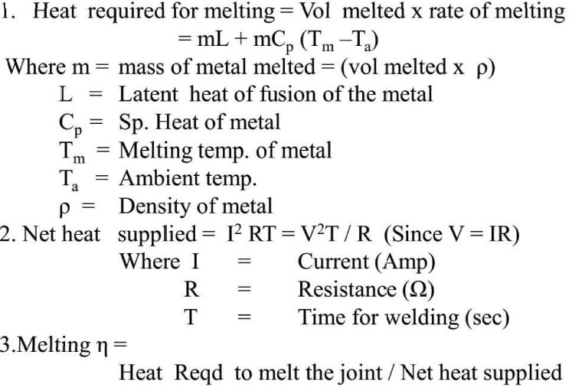
Principle of Resistance Welding

Slide 4
Resistance Welding Equipment
Principal elements of resistance welding:
Welding transformer, electrical circuits connected with electrodes and current regulator.
A mechanical system consisting of a machine structure and mechanisms to hold the electrode and apply the welding pressure.
The control equipment to control the current magnitude and time.

Slide 5
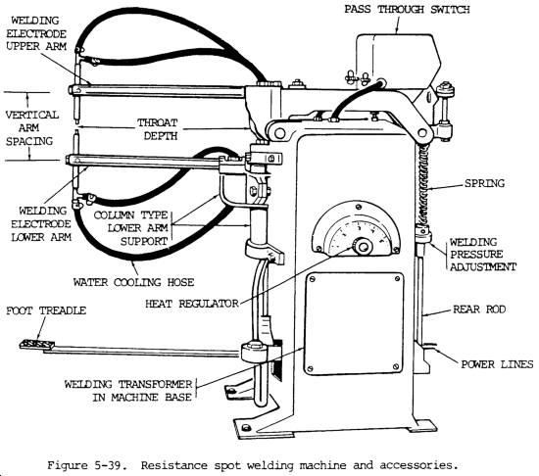
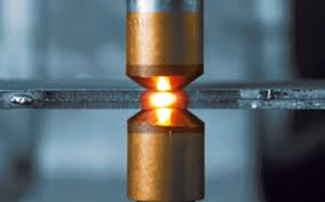
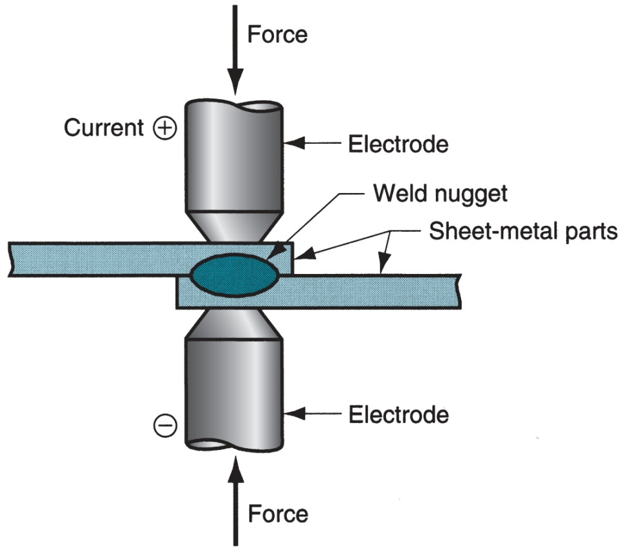
Resistance welding equipment Ex. spot welding [2]
Resistance Welding Equipment (Spot Welding)

Slide 6
Spot Welding Process

Slide 7
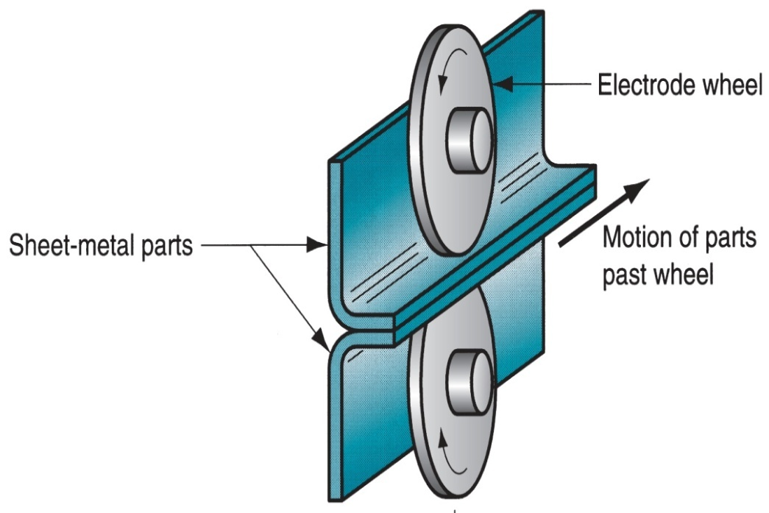
Seam Welding Process
In this process disk type electrodes are used.
Produce continuous type of welding between two sheets.
Disk are made up of cupper and current is applied through it
Current is applied in pulse form in time intervals
Disks are rotate continuously so that metal sheets moves forward.
To manufacture seam welded pipes

Slide 8
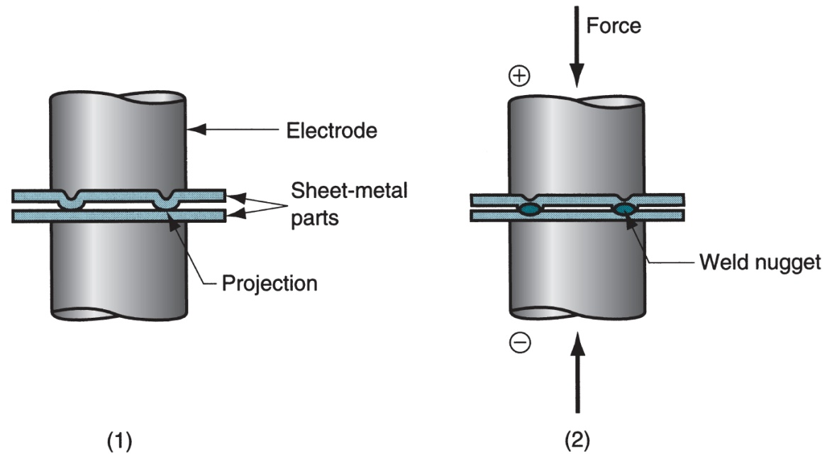
Projection Welding Process
It is modification of spot welding. Where one of the sheet is provided with projections and other is plane. These projections are in circular form.
There diameter is equal to thickness of plate.
During this process sheets to welded are kept between electrodes which made of cupper.
Current and pressure is get concentrated at projection areas during process.
Pressure is applied by upper
movable electrode and lower
is fixed .
By passing current these
projections get melted and
welding is done.

Slide 9
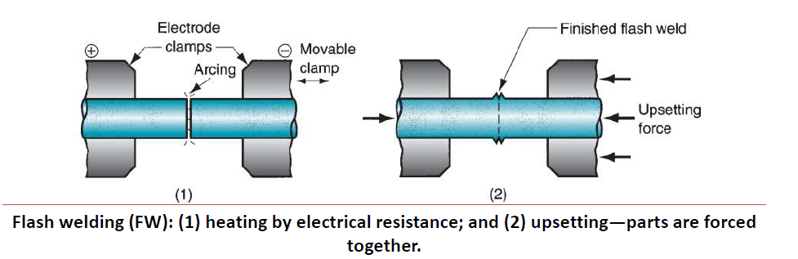
Flash Butt Welding Process

Slide 10
Flash Butt Welding Process
In flash welding (FW), normally used for butt joints, the two surfaces to be joined are brought into contact or near contact and electric current is applied to heat the surfaces to the melting point, after which the surfaces are forced together to form the weld.
In addition to resistance heating, some arcing occurs (called flashing, hence the name of the welding process)between the faying surfaces, so flash welding is sometimes classified in the arc welding group.
Current is usually stopped during upsetting.

Slide 11
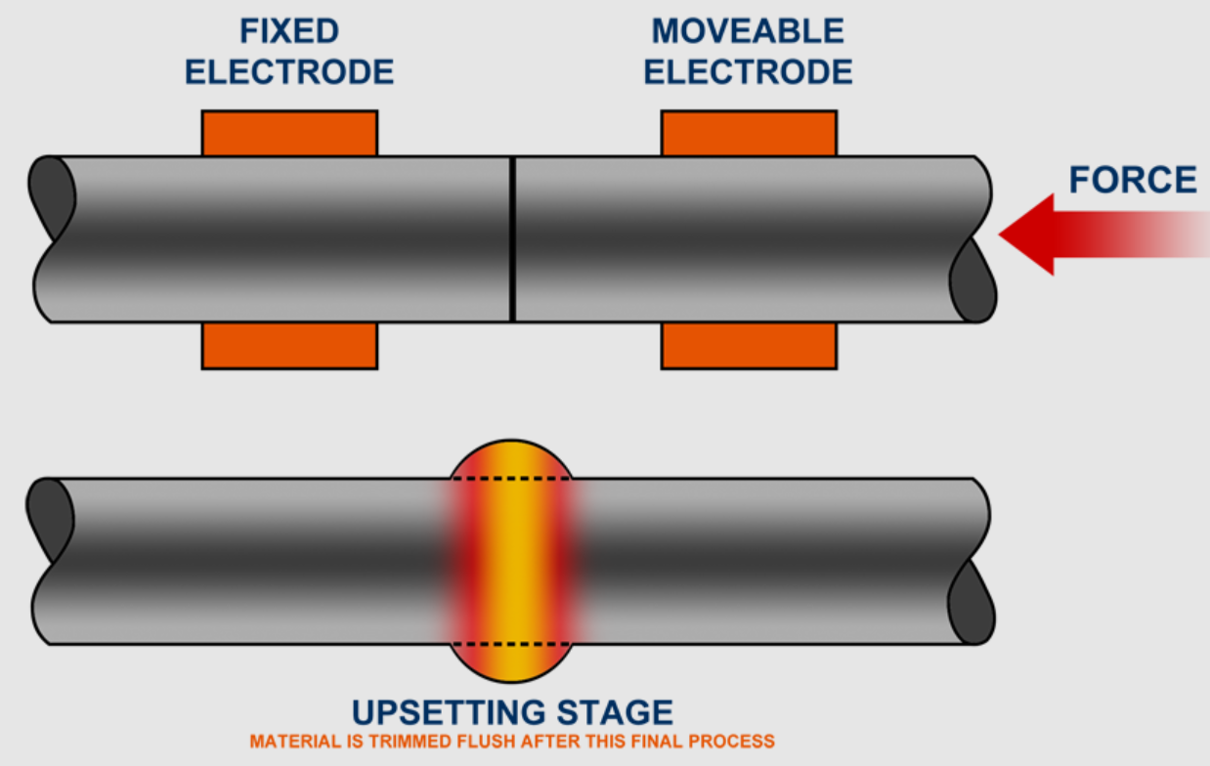
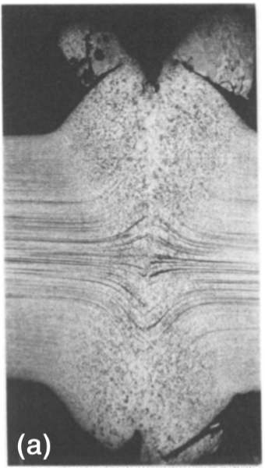
Upset Butt Welding Process

Slide 12
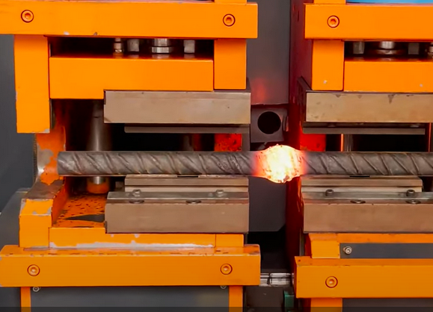
Upset Butt Welding Process

Slide 13
Upset Butt Welding Process
Upset welding (UW) is similar to flash welding except that in UW the faying surfaces are pressed together during heating and upsetting.
• In flash welding, the heating and pressing steps are separated during the cycle.
• Heating in UW is accomplished entirely by electrical resistance at the contacting surfaces; no arcing occurs.
• When the faying surfaces have been heated to a suitable temperature below the melting point, the force pressing the parts together is increased to cause upsetting and coalescence in the contact region.
• Thus, upset welding is not a fusion-welding process in the same sense as the other welding processes we have discussed.

Slide 14
References / Further Readings
[1] Ghosh, A. & Mallik, A.K.; Joining processes, Manufacturing Science, Latest edition.
[2] http://mewelding.com/resistance-welding-equipment/
[3] Kalpakjian, S & Schmid, S,; Manufacturing Processes for Engineering Materials, Latest edition.

Slide 15


